Slide 1
Simulated annealing (Random & Greedy)
Simulated annealing is a probabilistic technique for approximating the global optimum of a given function.
Specifically, it is a metaheuristic to approximate global optimization in a large search space for an optimization problem. It is often used when the search space is discrete (e.g., the traveling salesman problem).
For problems where finding an approximate global optimum is more important than finding a precise local optimum in a fixed amount of time, simulated annealing may be preferable to exact algorithms such as gradient descent.

Slide 2
Overview
In general, simulated annealing algorithms work as follows. The temperature progressively decreases from an initial positive value to zero. At each time step, the algorithm randomly selects a solution close to the current one, measures its quality, and moves to it according to the temperature-dependent probabilities of selecting better or worse solutions.
The state of some physical systems, and the function E(s) to be minimized, is analogous to the internal energy of the system in that state. The goal is to bring the system, from an arbitrary initial state, to a state with the minimum possible energy.

Slide 3
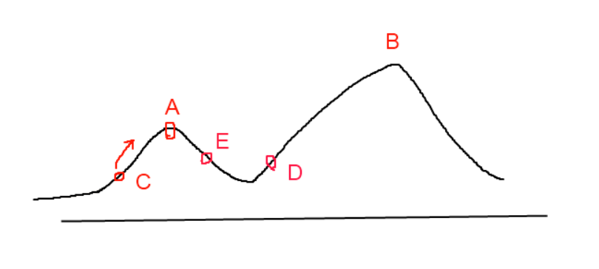
Hill Climbing (greedy) & Simulated Annealing
Simple heuristics like hill climbing, which move by finding better neighbour after better neighbour and stop when they have reached a solution which has no neighbours that are better solutions, cannot guarantee to lead to any of the existing better solutions – their outcome may easily be just a local optimum, while the actual best solution would be a global optimum that could be different. Metaheuristics use the neighbours of a solution as a way to explore the solution space, and although they prefer better neighbours, they also accept worse neighbours in order to avoid getting stuck in local optima; they can find the global optimum if run for a long enough amount of time.

Slide 4
Simulated annealing searching for a maximum. The objective here is to get to the highest point; however, it is not enough to use a simple hill climb algorithm, as there are many local maxima. By cooling the temperature slowly the global maximum is found.

Slide 5
Main steps of simulated annealing
Set an initial temperature T.
The temperature drops and the state shifts. From the current temperature, decrease to the next temperature according to the cooling coefficient. At the new temperature, the current state is calculated.
If the temperature drops to the preset end temperature, the program terminates.

Slide 6
Strange Function

Slide 7
Disadvantages of simulated annealing
1. Not a precise solution.
2. The choices of T, delta and eps can have a significant impact on the method’s performance. Unfortunately, there are no choices of these parameters that will be good for all problems, and there is no general way to find the best choices for a given problem.

Slide 8
Randomized algorithm
A randomized algorithm is an algorithm that employs a degree of randomness as part of its logic. The algorithm typically uses uniformly random bits as an auxiliary input to guide its behavior, in the hope of achieving good performance in the "average case" over all possible choices of random determined by the random bits; thus either the running time, or the output (or both) are random variables.
One has to distinguish between algorithms that use the random input so that they always terminate with the correct answer, but where the expected running time is finite (Las Vegas algorithms, for example Quicksort), and algorithms which have a chance of producing an incorrect result (Monte Carlo algorithms) or fail to produce a result either by signaling a failure or failing to terminate. In some cases, probabilistic algorithms are the only practical means of solving a problem.

